Slide 1
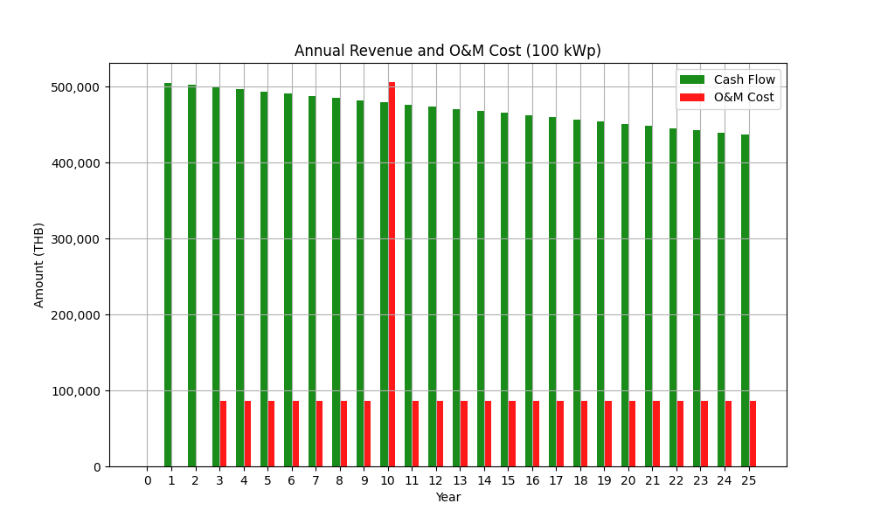
Image from EPC: Annual Revenue and O&M Cost 100 kW.png

Slide 2
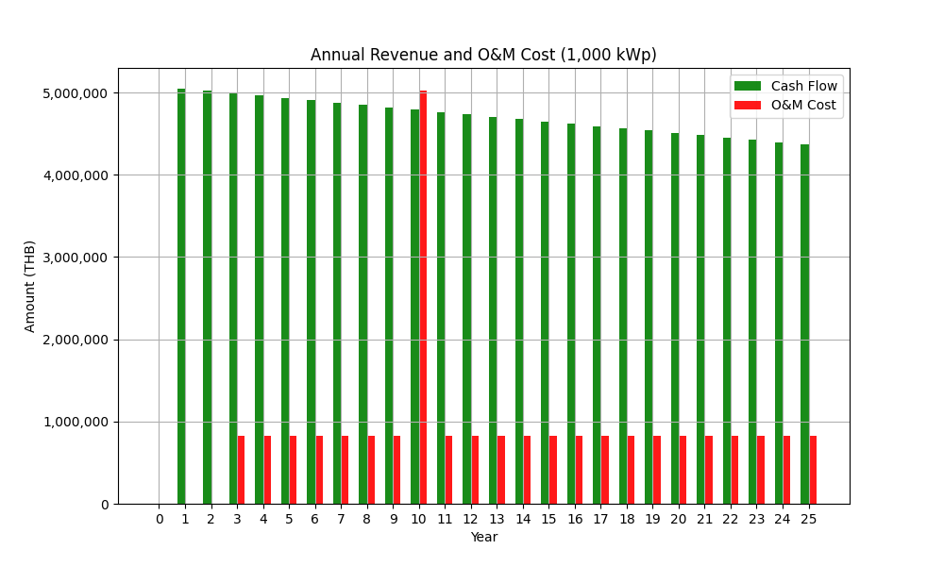
Image from EPC: Annual Revenue and O&M Cost 1000 kW.png

Slide 3

Image from EPC: Annual Revenue and O&M Cost 500 kW.png

Slide 4
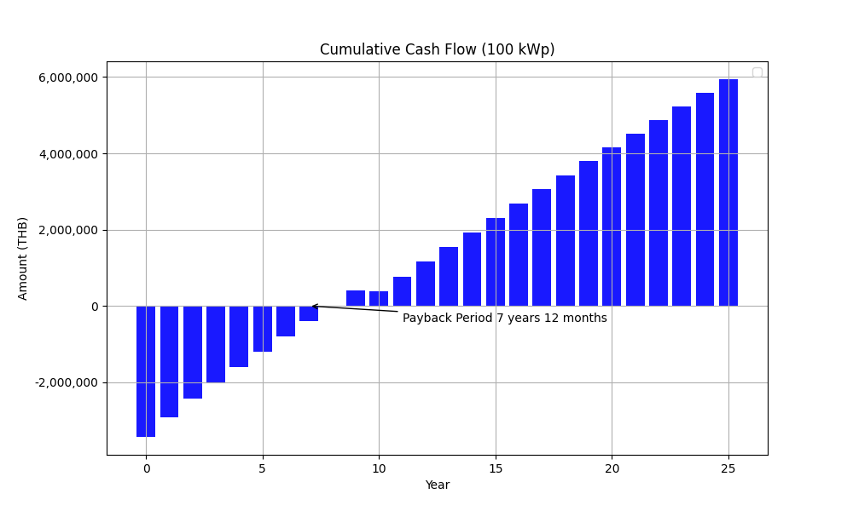
Image from EPC: Cumulative Cash Flow 100 kW.png

Slide 5
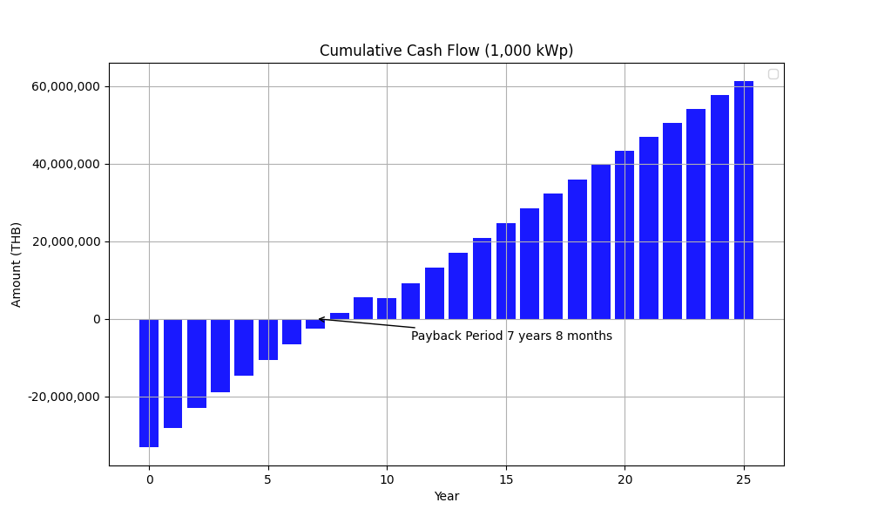
Image from EPC: Cumulative Cash Flow 1000 kW.png

Slide 6

Image from EPC: Cumulative Cash Flow 500 kW.png

Slide 7
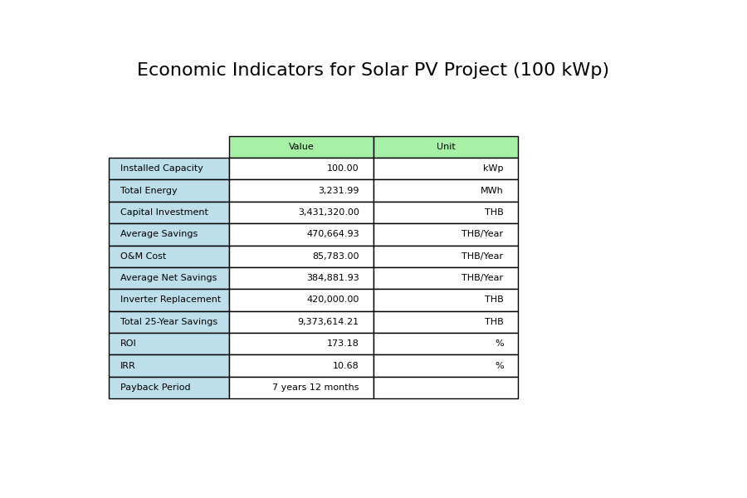
Image from EPC: Economic Indicators for Solar PV Project 100 kW.png

Slide 8
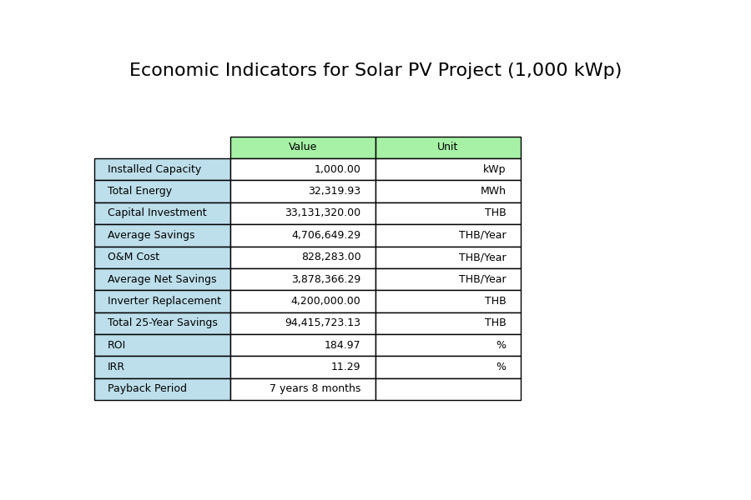
Image from EPC: Economic Indicators for Solar PV Project 1000 kW.png

Slide 9
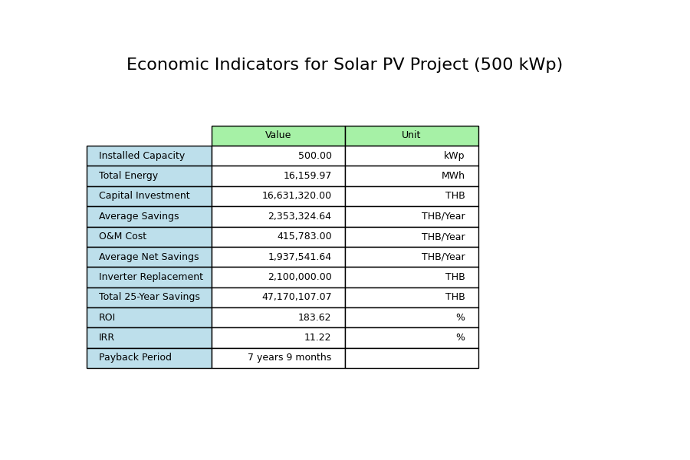
Image from EPC: Economic Indicators for Solar PV Project 500 kW.png

Slide 10
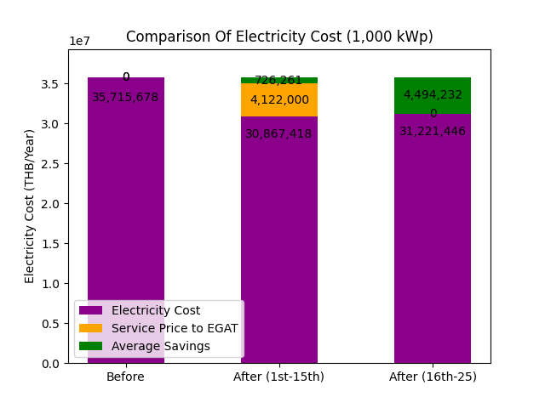
Image from GSA: Electricity Cost Comparison 1,000kWp_15.0_15yr.png

Slide 11
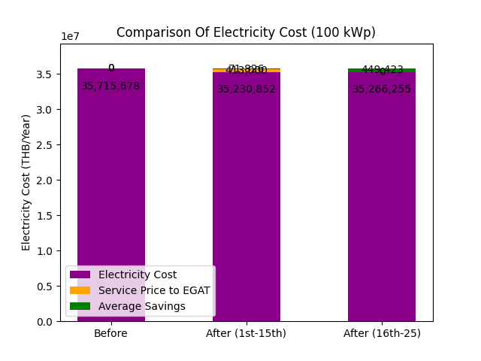
Image from GSA: Electricity Cost Comparison 100kWp_15.0_15yr.png

Slide 12
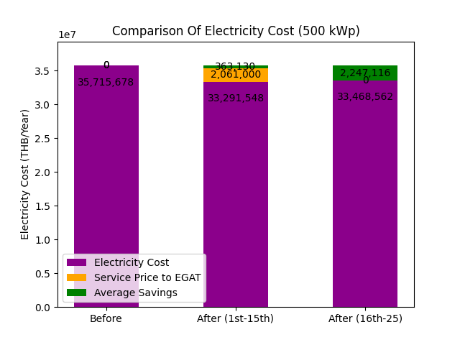
Image from GSA: Electricity Cost Comparison 500kWp_15.0_15yr.png

Slide 13
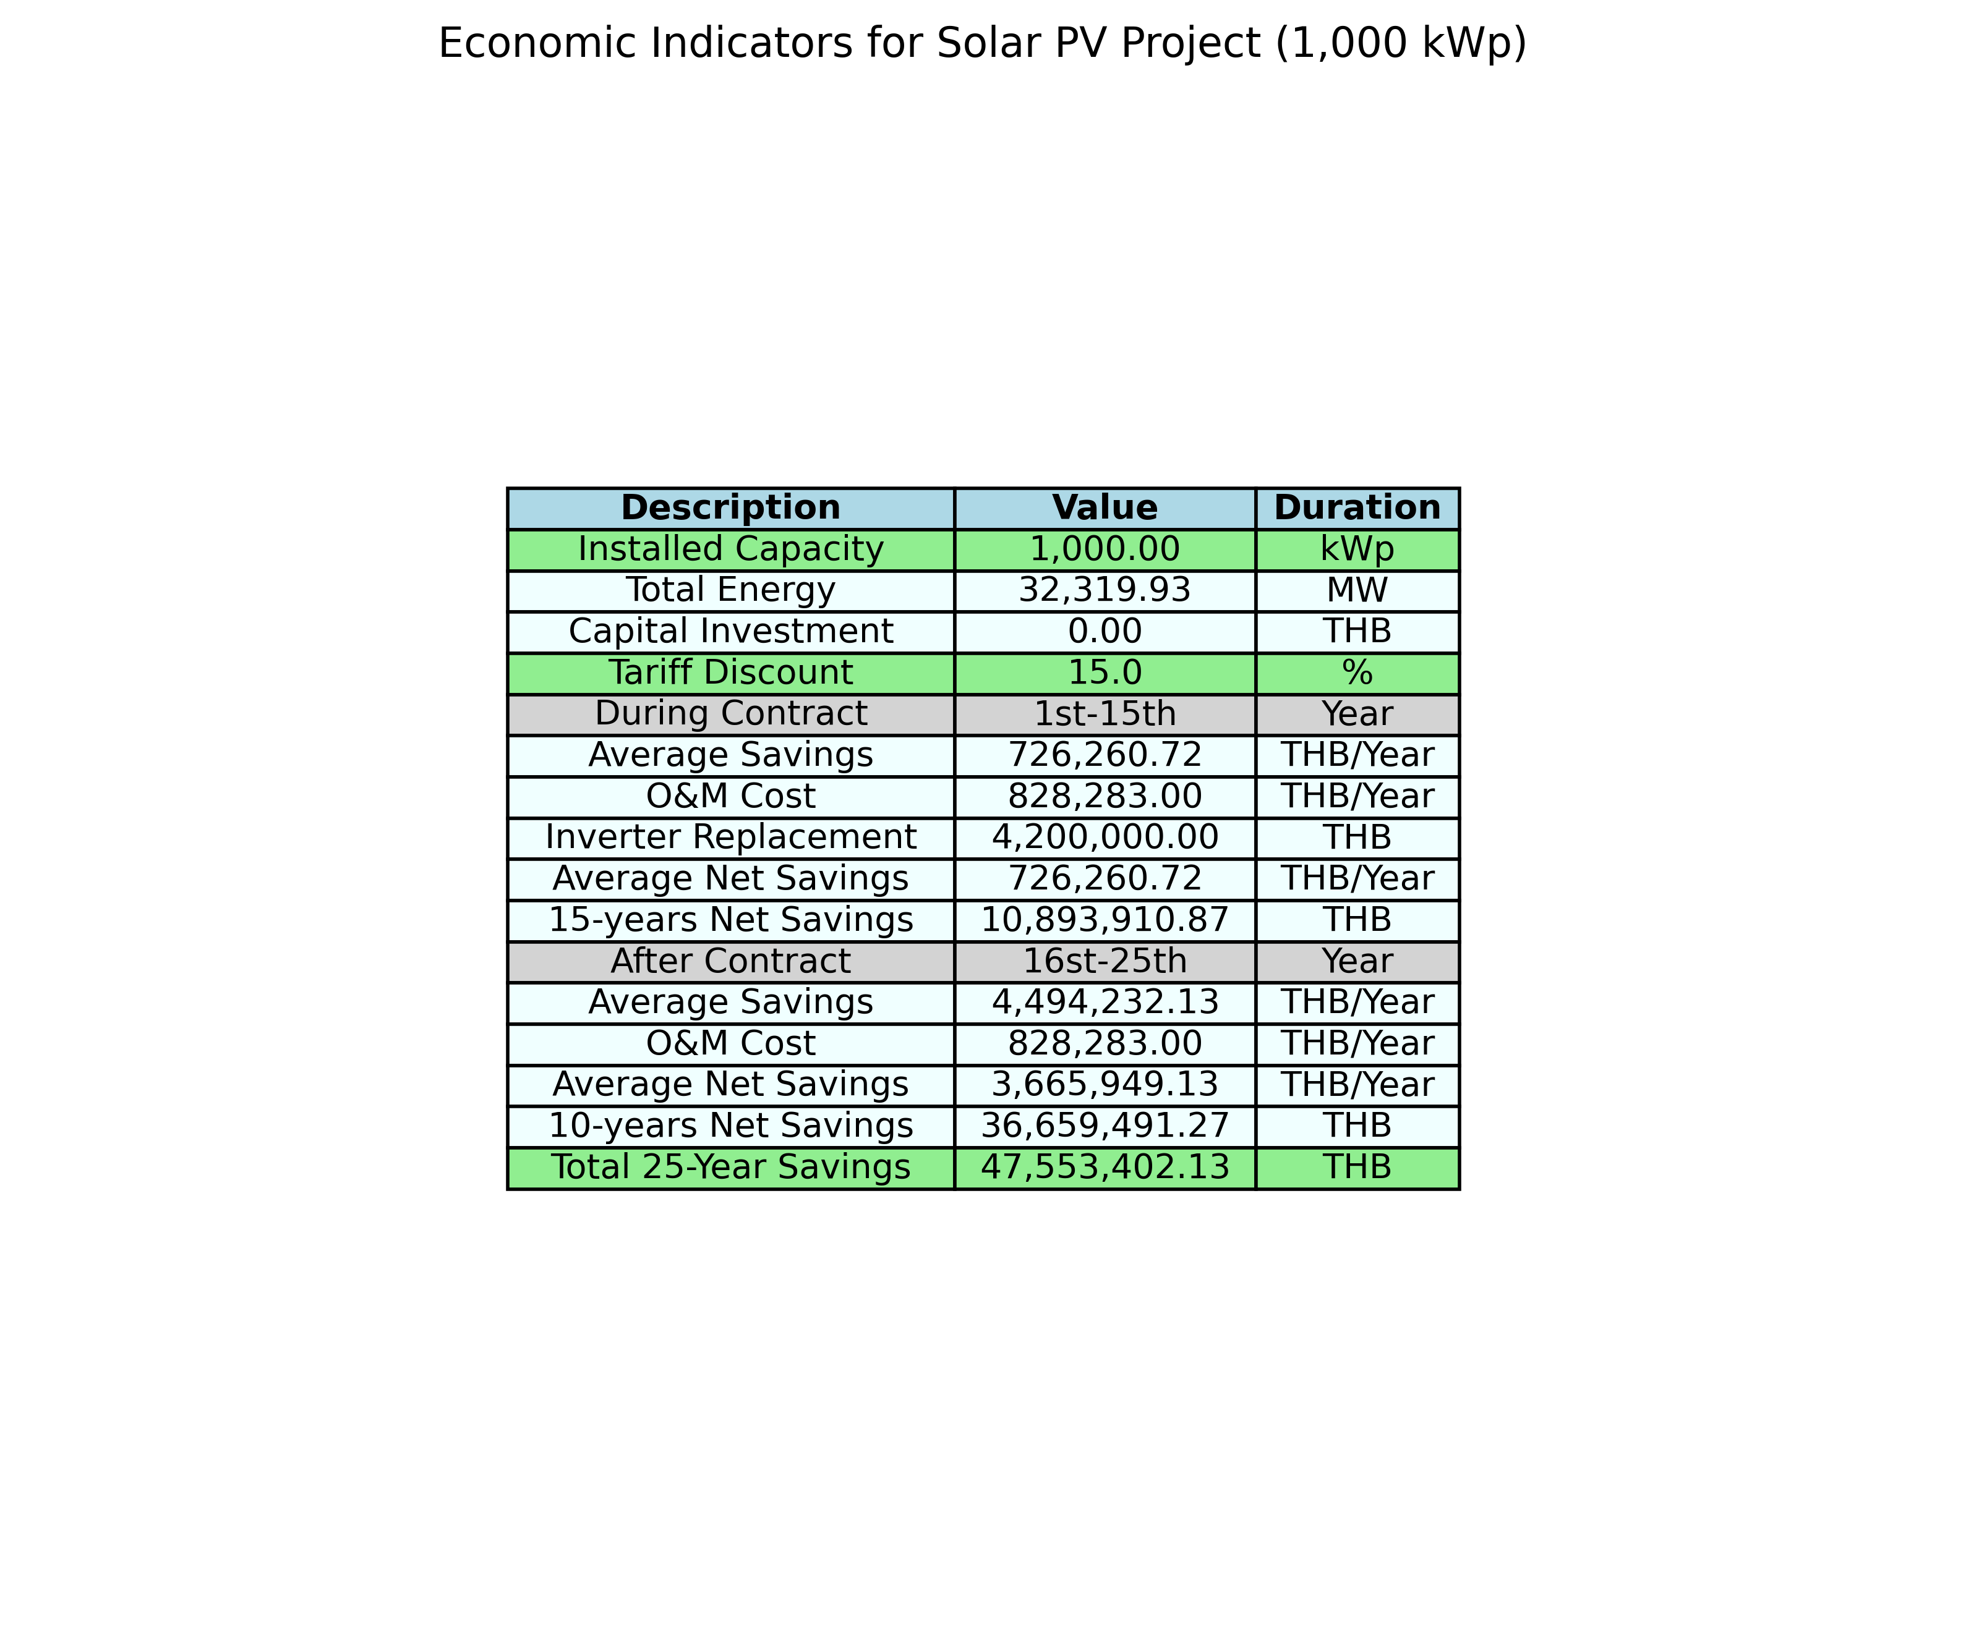
Image from GSA: Table image 1,000 kWp 15.0_15 yr.png

Slide 14
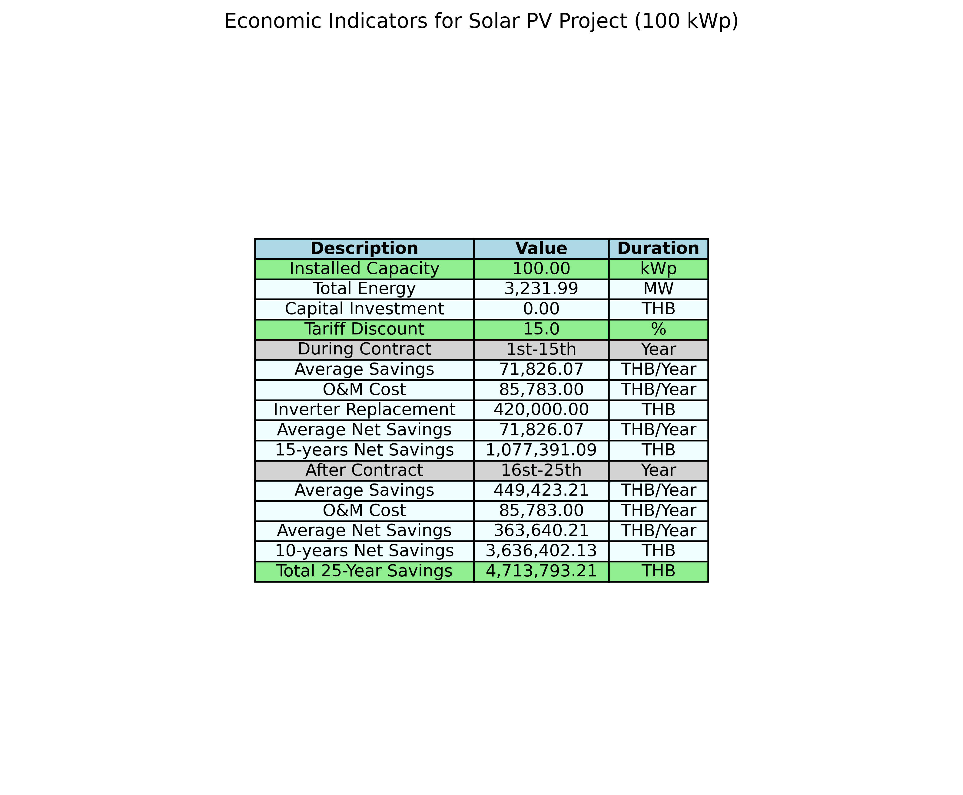
Image from GSA: Table image 100 kWp 15.0_15 yr.png

Slide 15
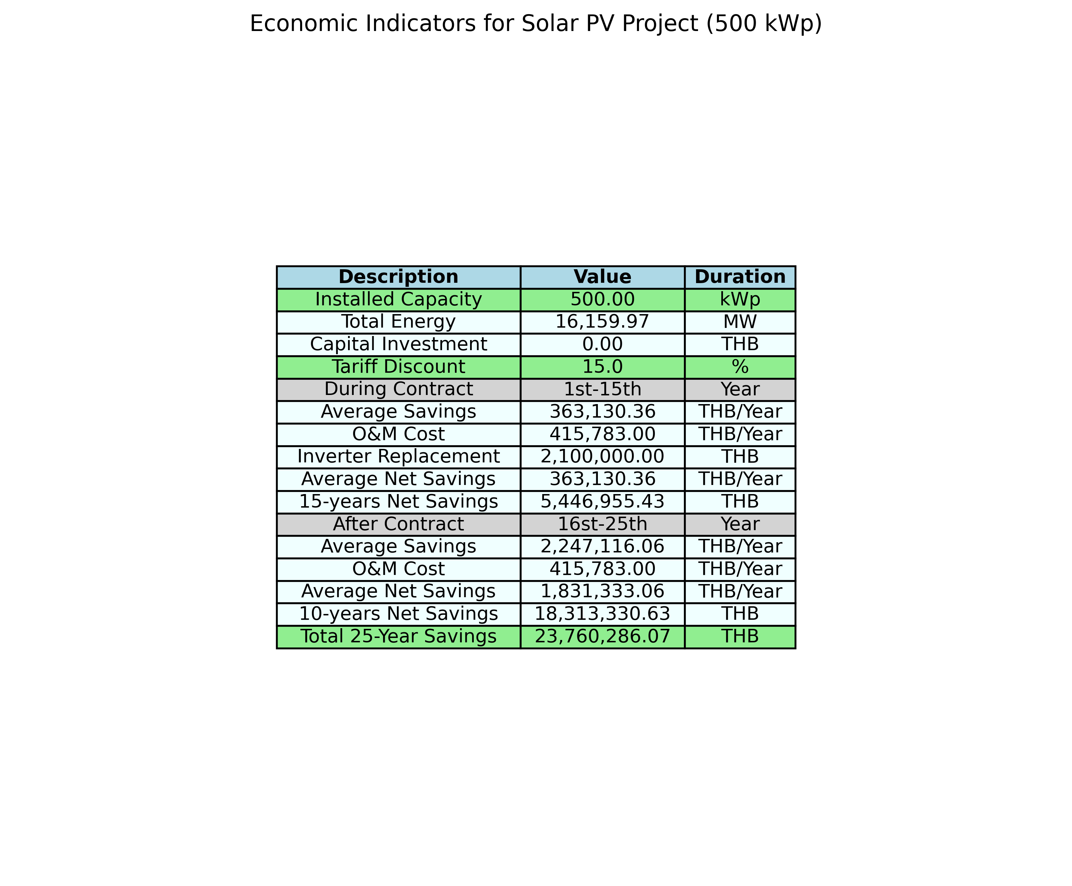
Image from GSA: Table image 500 kWp 15.0_15 yr.png

